Slide 1
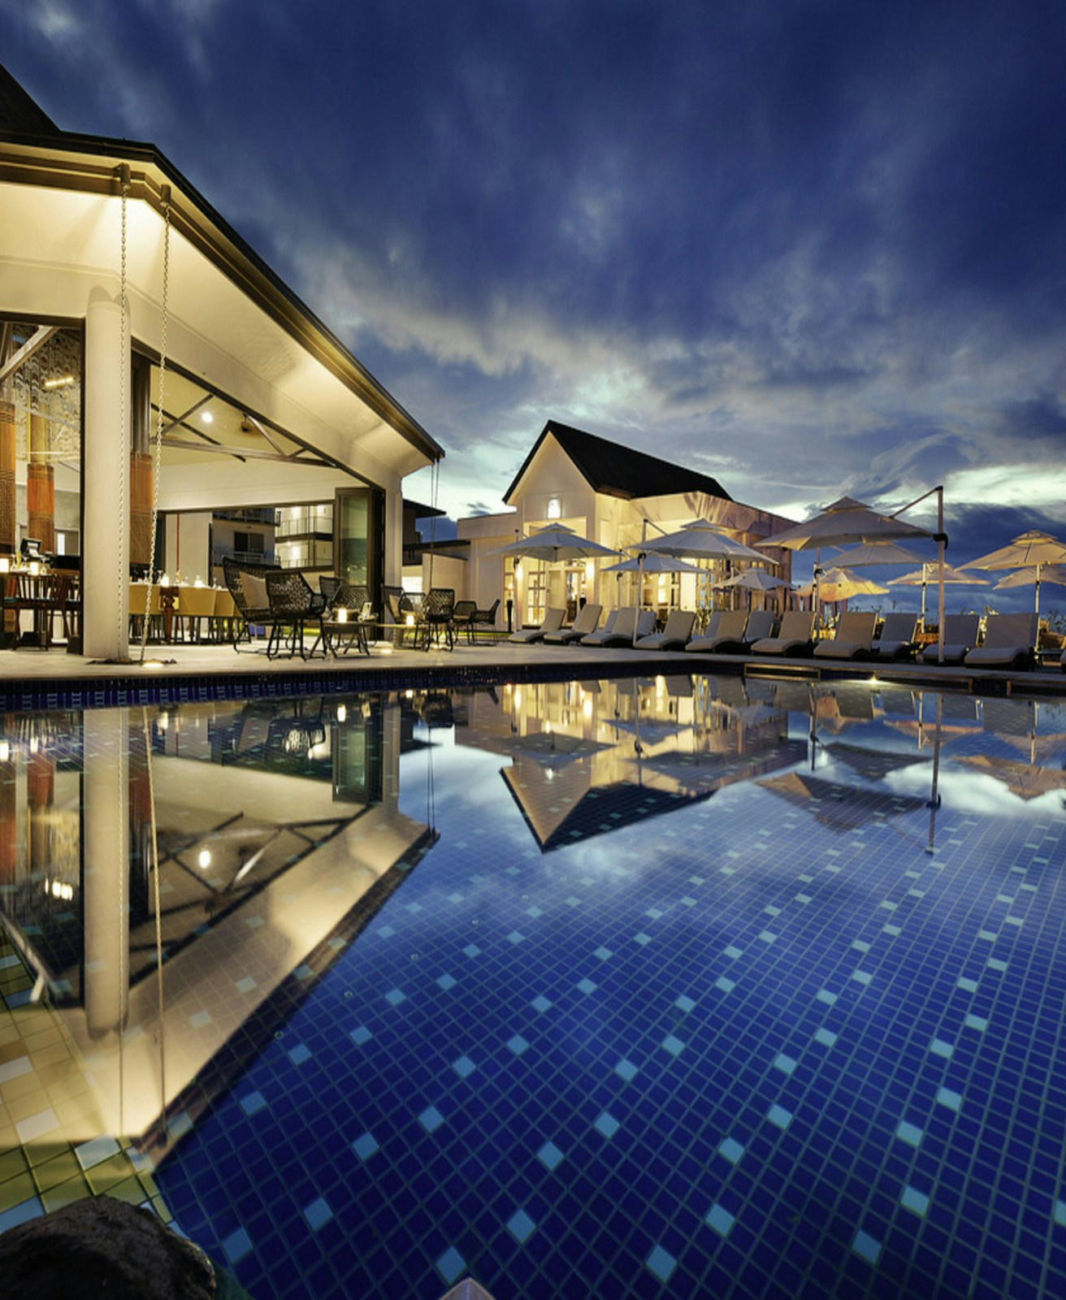
IBRAHIM STUDIO
Hotel and resort websites
Help guests understand the stay before they enquire.
Stillwater demonstration
25 October 2026
Notes:
Illustrative photograph used on the Ibrahim Studio demo. Source: https://images.unsplash.com/photo-1571896349842-33c89424de2d. Not a real Ibrahim Studio client property.

Slide 2
Essential
A clear business presence
01
Room collection and guest capacities
Production scope
A hotel supplies room types, availability rules, approved imagery and a booking engine. Channel-manager and payment connections are separately scoped.
02
Experiences, gallery and stay request
03
Date and night-count validation
Ibrahim Studio / 02
Notes:
Feature statements reflect the existing source routes. Demos are fictional and all business transactions are local simulations. Package scope is defined separately and does not include every demonstration feature.

Slide 3
Interactive
Useful tools for choosing
01
Travel moods and a personal stay planner
02
Room, guest and experience selection
03
Transparent sample package totals
Ibrahim Studio / 03
Notes:
Existing implementation source and demo routes at https://ibrahim-services-studio.rockyox34.chatgpt.site/demos/hotel/interactive . Browser-local persistence. No real operational integration is implied.

Slide 4
3D Signature
01
Continuous arrival, lobby and corridor route
Model context
Conceptual resort with licensed furniture. Room photography is illustrative. It is not a scan or a complete digital twin of an operating hotel.
02
Room selection leads into a connected suite
03
Bedroom, living space, bathroom and terrace
WebGL quality depends on the device. A non-3D path remains available.
Ibrahim Studio / 04
Notes:
Conceptual resort with licensed furniture. Room photography is illustrative. It is not a scan or a complete digital twin of an operating hotel.
Source: existing demo implementation and visible asset credits. AURA: https://sketchfab.com/3d-models/vr-apartment-fb1b717d457540129c6bf45315aa2612 CC BY 4.0. Furniture: https://github.com/KhronosGroup/glTF-Sample-Assets/tree/main/Models/SheenChair CC0 and /GlamVelvetSofa CC BY 4.0. Ferrari: https://sketchfab.com/models/57bf6cc56931426e87494f554df1dab6 CC BY 4.0. Cloud QA cannot verify live GPU rendering.

Slide 5
Scoped starting prices
Edition | One-time build fee | Planning basis
Essential | INR 19,999 | Supplied content
Interactive | INR 49,999 | One agreed workflow
3D Signature | INR 1,99,999 | Suitable supplied 3D assets
One supplied environment, up to five zones and one representative suite type. Extra rooms are scoped separately.
Asset creation, visits, travel, paid services and applicable taxes are additional. Written scope controls the total. Prices reviewed 25 October 2026.
Ibrahim Studio / 05
Notes:
Ibrahim Studio proposed rate card, not a market average. Benchmarks reviewed 25 October 2026: https://www.webdesignerindia.in/packages/website-design-plans/
https://launchroom.in/pricing
https://www.studiokalex.com/blog/3d-website-cost-india-2026-pricing-guide
https://www.studiokalex.com/blog/3d-product-rendering-cost-india-2026-pricing-guide
Scope and fees match lib/studio.ts and the PDF guide.

Slide 6
The work behind the experience
3D production and site visits
A clear working agreement
Half-day on site: INR 7,500
Full-day on site: INR 12,500
Travel, scanner rental and specialist capture are separately approved. Models and reconstruction receive their own quote.
40% kickoff, 40% prototype, 20% handover
Two consolidated revision rounds
30 days of agreed-scope defect fixes
Cancellation accounts for completed work and approved costs. Unearned balances are refundable under the agreement and applicable law.
Ibrahim Studio / 06
Notes:
Ibrahim Studio commercial guidelines. Location visits require owner permission and a capture plan. No guarantee of a perfect scan. See /terms and PDF for complete conditions. Terms do not waive statutory consumer rights.

Slide 7
Your project brief
Shaik Ibrahim
contact@ibrahimshaik.com
Share your business goal, target launch window and budget.
For 3D, include existing models, plans and the location city.
Explore demos and prepare an enquiry
Future domain: services.ibrahimshaik.com. Publication and DNS setup are separate launch steps.
Ibrahim Studio / 07
Notes:
Current deployment preserves owner-private access. Shareable domain access needs an explicit audience choice and DNS configuration. Studio contact form prepares a brief locally for the visitor to send through email. No server mail delivery is configured. Planned domain is not presented as a verified live URL.

